Slide 1
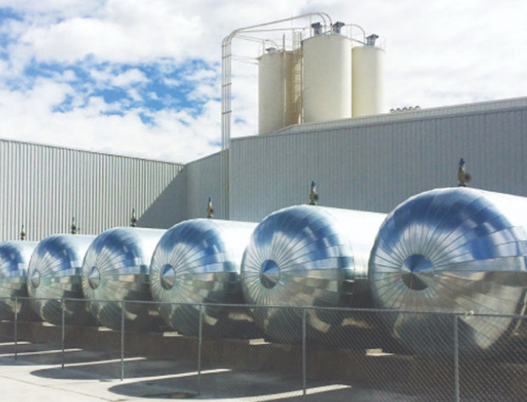
Catalog 2022
USMEX ADVISORS

Slide 2
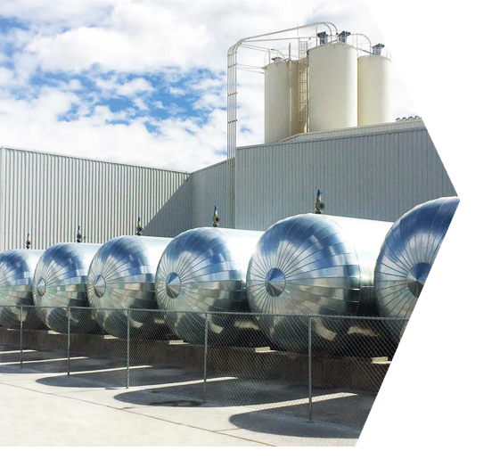
Advantages for the Contractor
Structural – 580 psi strength, shear resistance 475lb/sq ft.
Lightweight – weighs 60% less than conventional concrete.
No Special Tools Needed/Easy Installation – walls are ready to pain in 4 days versus 30 days of 3-coat stucco. Easy to cute, drill, punch, groove and sand with conventional equipment.
High Quality Manufacturing – panels are constructed in a world-class automated manufacturing plant complying with ASTM standards.
Cost Effective – 40% less than 3-coat stucco system
Eco-Friendly – Made100% from natural materials containing no foam or plastics. No need for plywood.
LOCATION/ 20 MILES NORTH MEXICO CITY

Slide 3
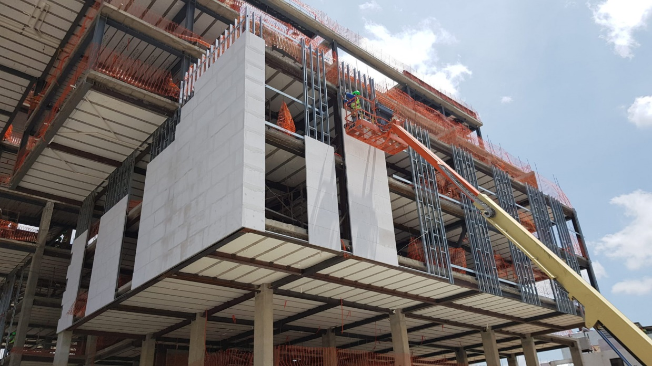
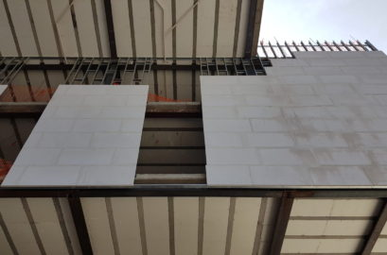
Advantages for The Customer
Solid Construction – strong, durable reinforced concrete panels that create a strong building exterior
UL Fire Rated – fire resistant for 1 hour and 40-minute versus stucco which is only fire retardant
Sustainable – no maintenance required and lasts longer than traditional stucco
Weather/Water Resistant – lower humidity absorption than stucco; waterproof, does not deteriorate or form mold over time, water absorption rate percentage – 22.4%
Acoustic Insulation – reduces exterior noise by 28-32 STC, a significant improvement over stucco
Thermal Insulation – superior insulation over traditional materials for hot and cold weather
Energy Savings – with an R-value that is 12x higher than stucco your energy bill could be up to 30% lower

Slide 4
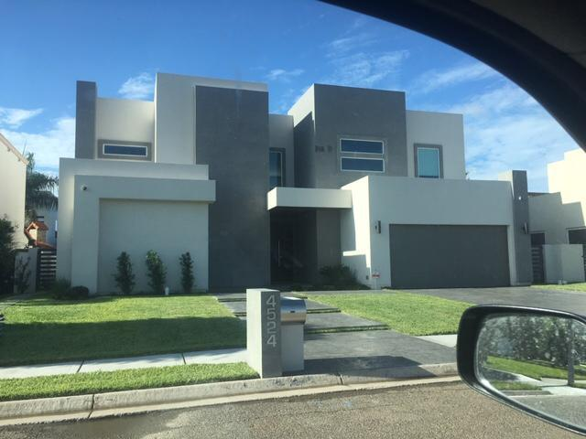

Slide 5
General Cladding Specs
Compressive strength - 580psi
Nominal Density – 30.4 lbs/cubic feet
Real Density – 33.4 lbs/cubic feet
Dry Shrinkage – 0.02%
Thermal Conductivity – 0.839 BTU
R Value – 2.3
Permeability – 6.58 US Perms
Moisture Absorption – 7.61 Wt%
Water Absorption – 22.4 WT%
Elastic Modulus 326.9 ksi
Acoustic Insulation (2” thick panels) – 28 STC

Slide 6
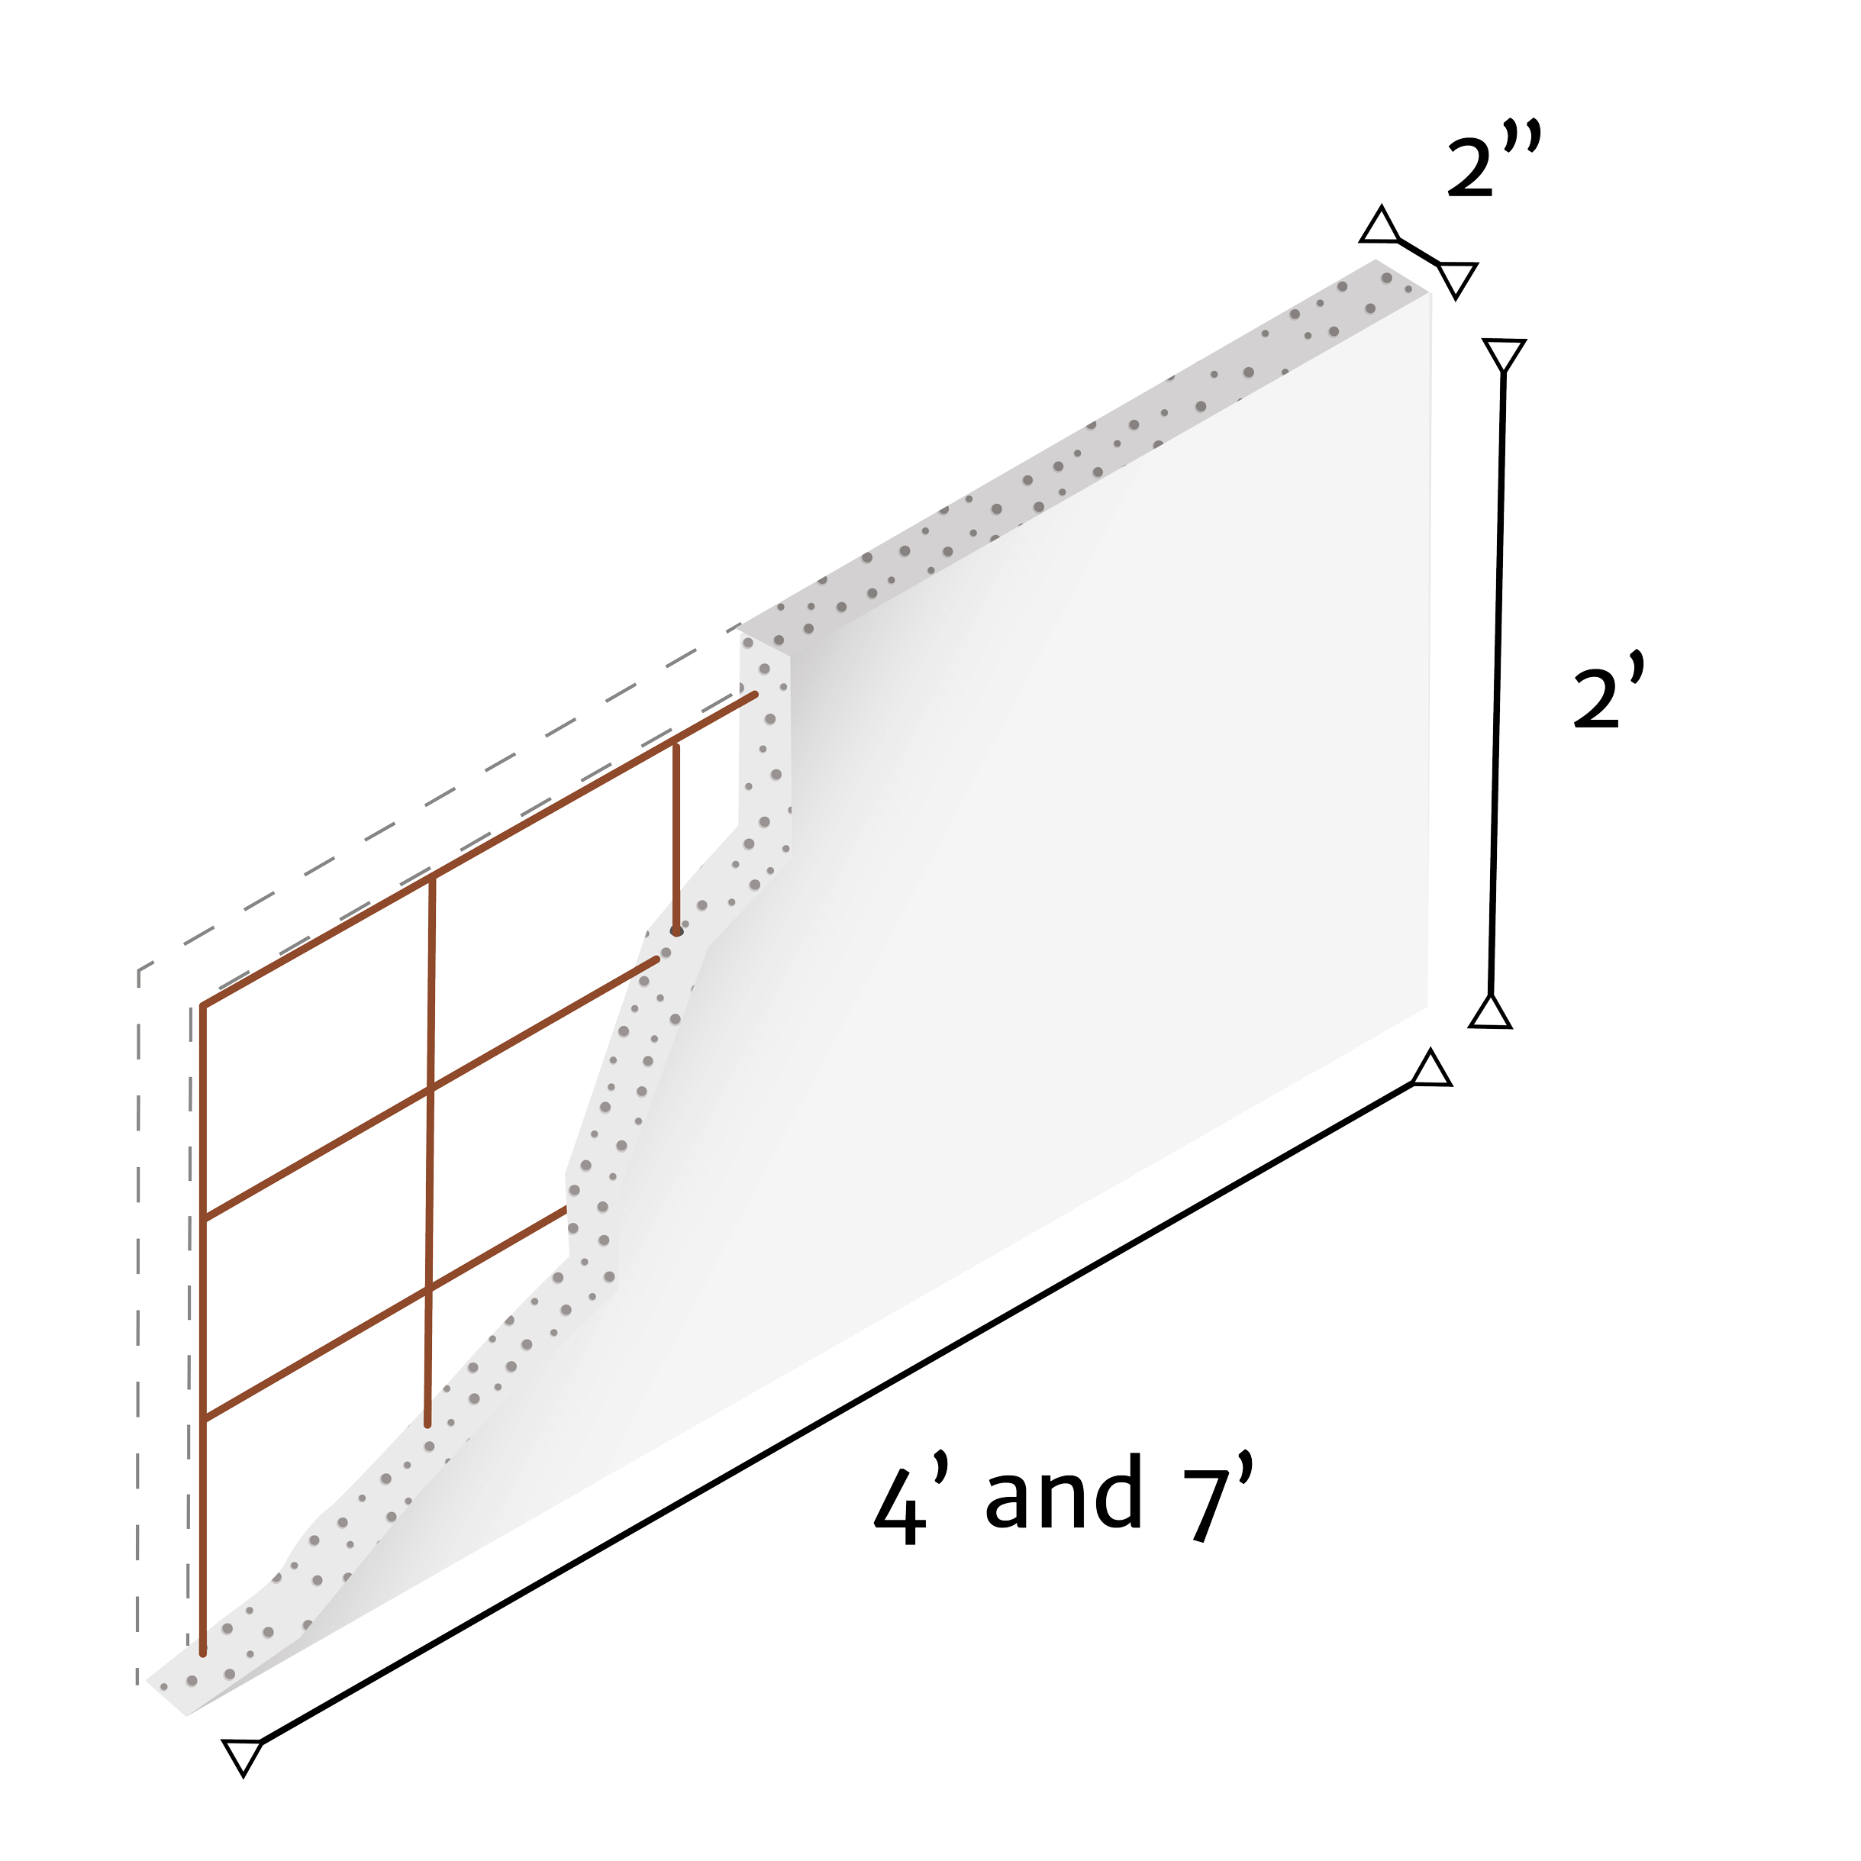
**Panel thickness can be greater than 2” if client request
**Longest panel length available is 18’, minimum panel length is 2’
Residential Cladding
*Standard size shown above
Product Description Façade cladding panels for traditional wood frame system. Standard size 2’x4’ and 2’x7’ panels with 2” thickness
Application Facades and exterior walls
Advantages Fast Installation – 700sq ft per day per 2–3-person crew Thin, lightweight and steel reinforced Super smooth finish, great for savings on finish coat Does not sag, warp, deform or crack Joints between panels remain invisible over time
Weight 5.12lbs/sq ft

Slide 7
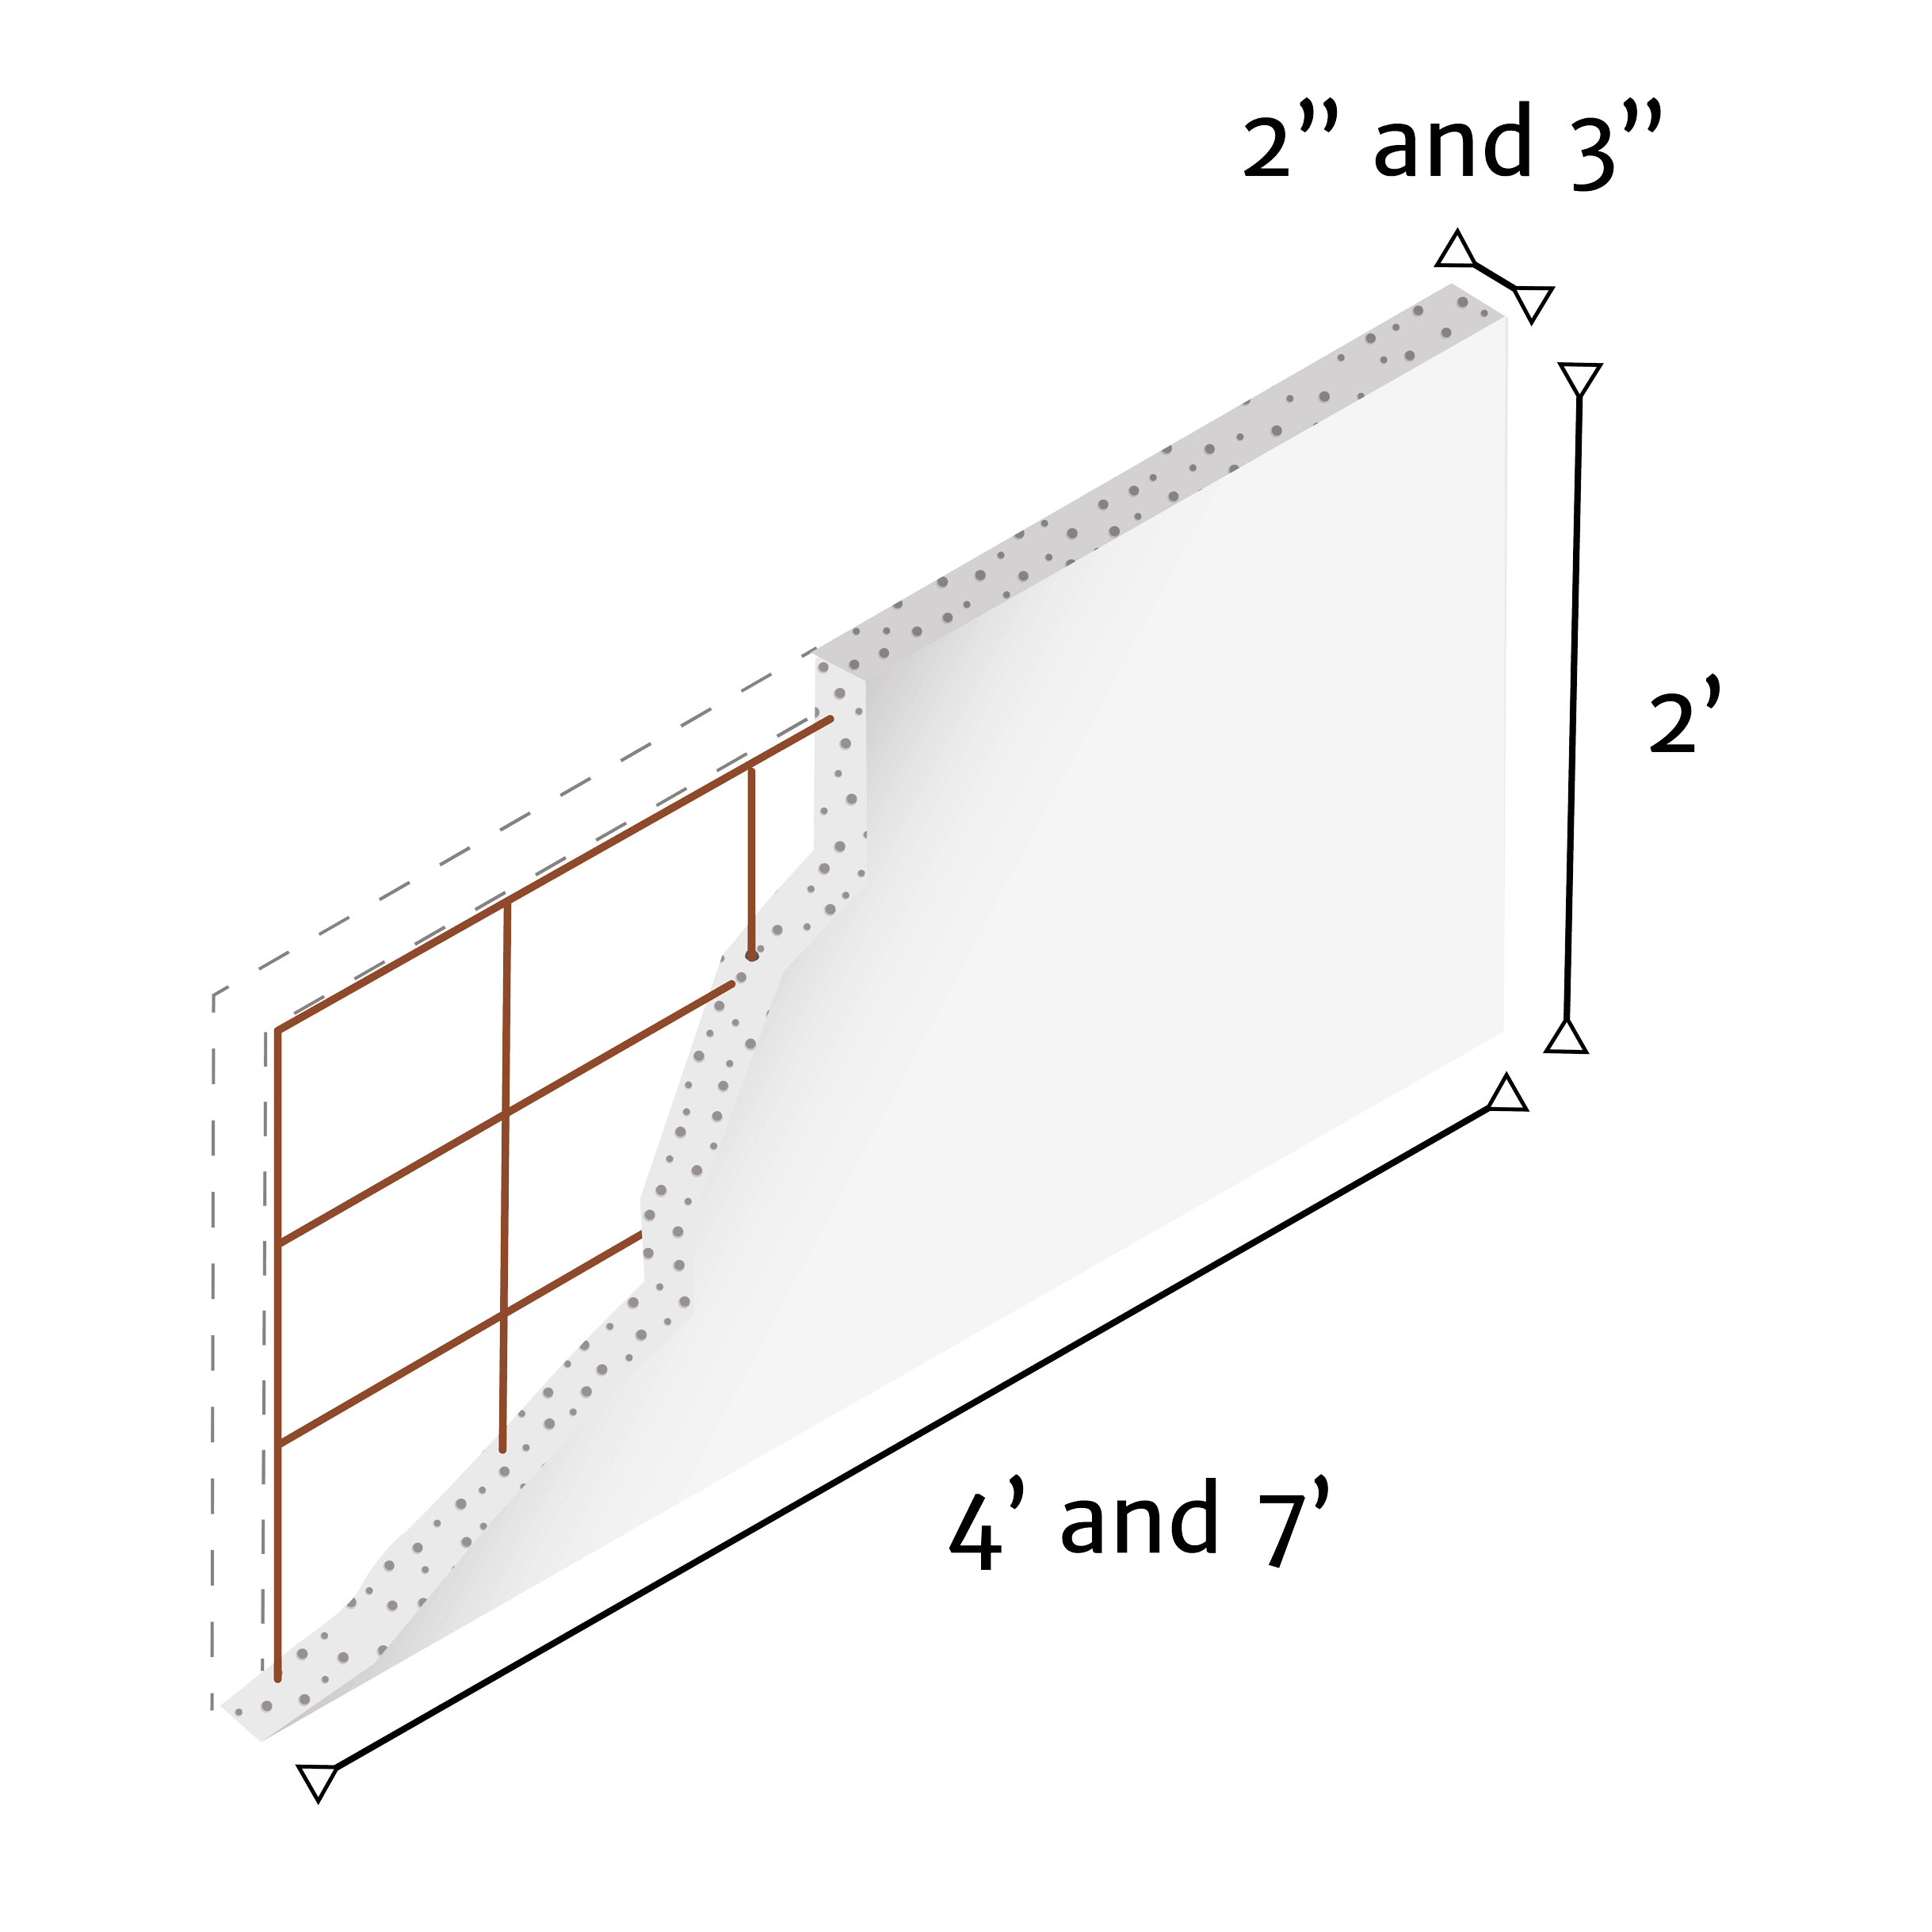
Commercial Cladding
*Standard size shown above
Description Façade cladding panels for steel or wood frame systems. Standard size 2’x4’ and 2’x7’ panels with 2”, 3” or more thickness
Application Facades and exterior walls
Advantages Fast Installation – 700sq ft per day per 2–3-person crew Thin, lightweight and steel reinforced Super smooth finish, great for savings on finish coat Does not sag, warp, deform or crack Joints between panels remain invisible over time
Weight 5.12lbs/sq ft

Slide 8
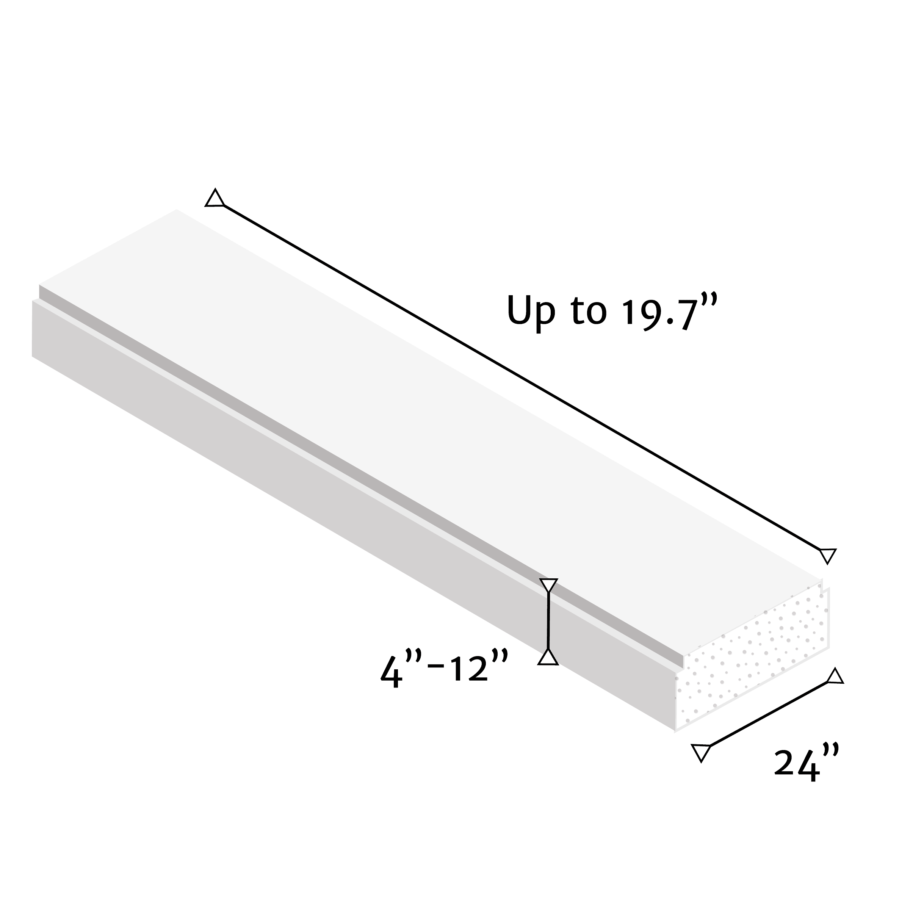
Floor and Roof Panel
*Standard size shown above
Description Steel reinforced panel for floor and roof, fy=1,707lbs/sq in
Application Floors and Roofs
Panels can be attached directly over steel frames, concrete or confined masonry walls
Advantages Fast installation Cost effective and light weight, reduces structural costs Requires less framing eliminates on-site casting for floor and roof installation
Weight 12.3 lbs/sq ft for 4” thick panels

Slide 9
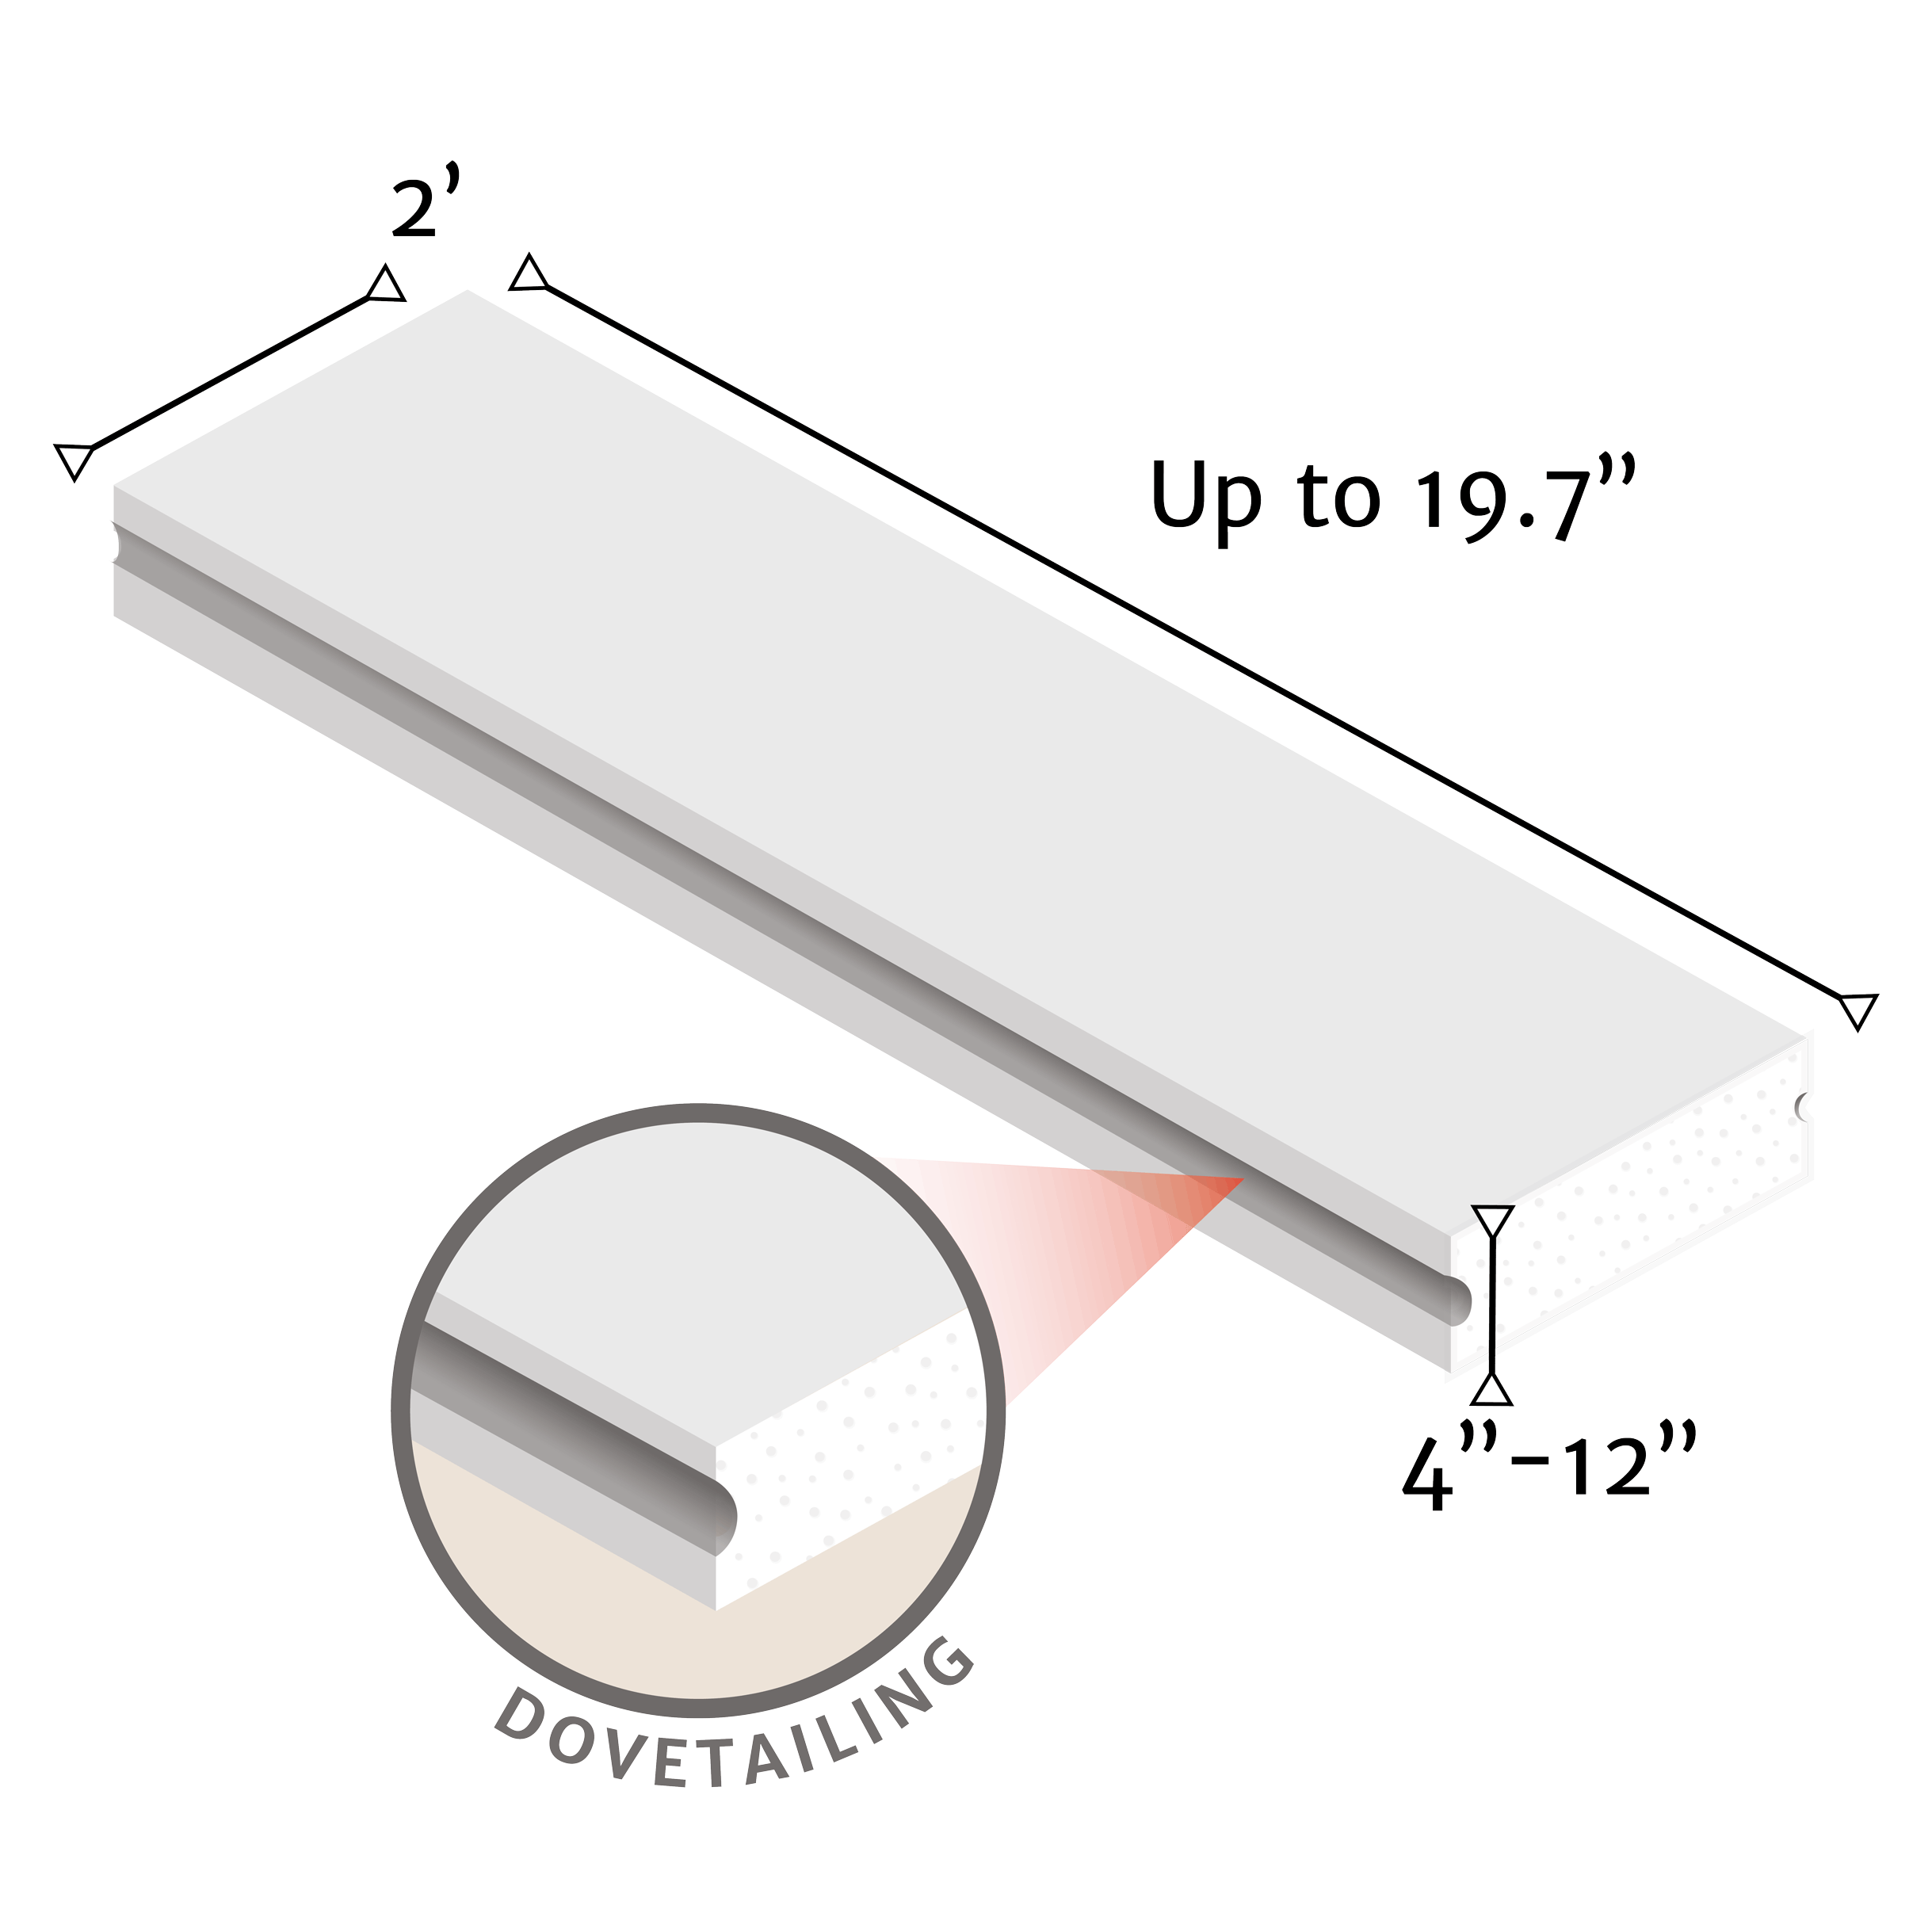
Industrial Panel
*Standard size shown above
Description Steel reinforced panel for industrial walls, fy=1,707lbs/sq in
Application Industrial warehouses, exterior and demising walls
Panels can be attached directly over steel frames, concrete or structural members.
Advantages Fast installation Some applications may not require adhesive Thermal, acoustic and fire resistant characteristics, result in a comfortable, safe and productive workspace
Weight 12.3 lbs/sq ft for 4” thick panels

Slide 10
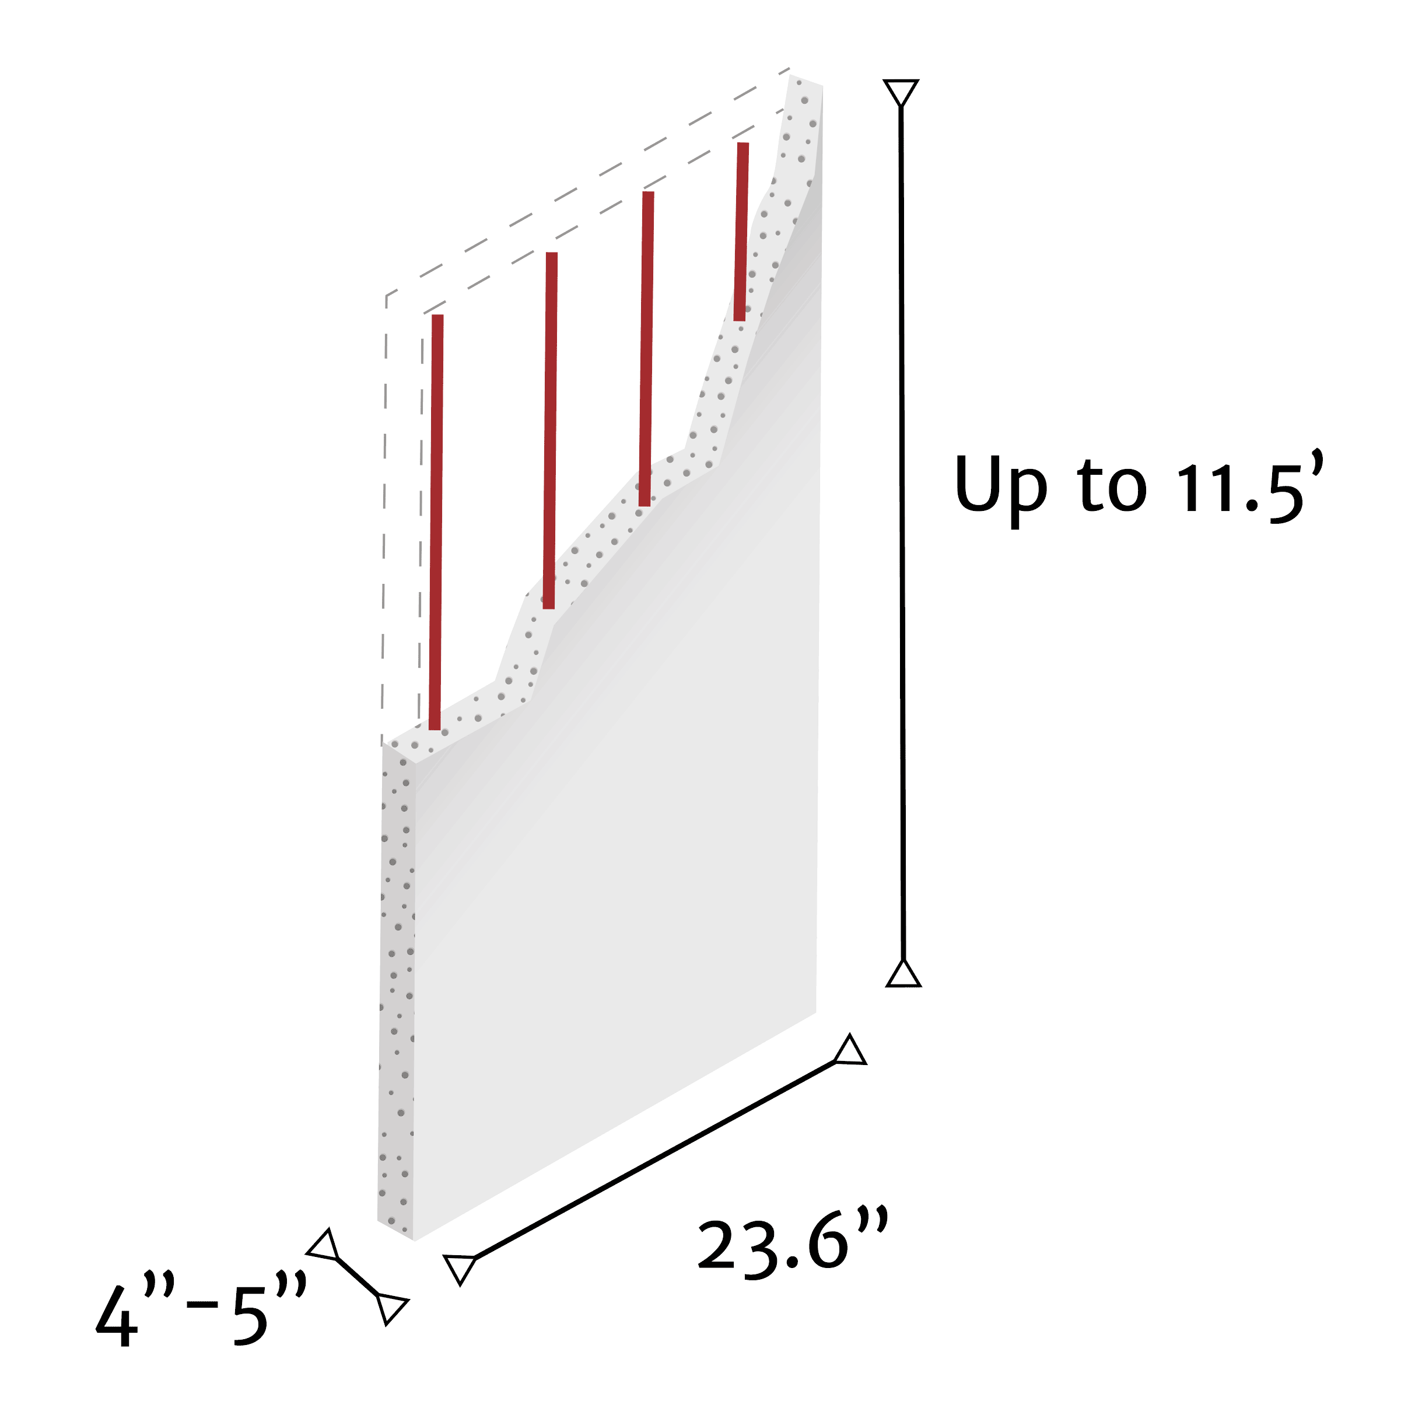
Partition Panel
*Standard size shown above
Description Steel reinforced demising wall panel. Single panel from floor to ceiling.
Application Non-load bearing partition walls up to 11.5’
Advantages Fast and most efficient installation on the market Supports direct attachment of heavy loads, i.e. TV, cabinets and more Solid partition wall, resistant to structural movements, will not drift or deflect Does not require additional reinforcement
Weight 10.7 lbs/sq ft for 4” thick panels

Slide 11
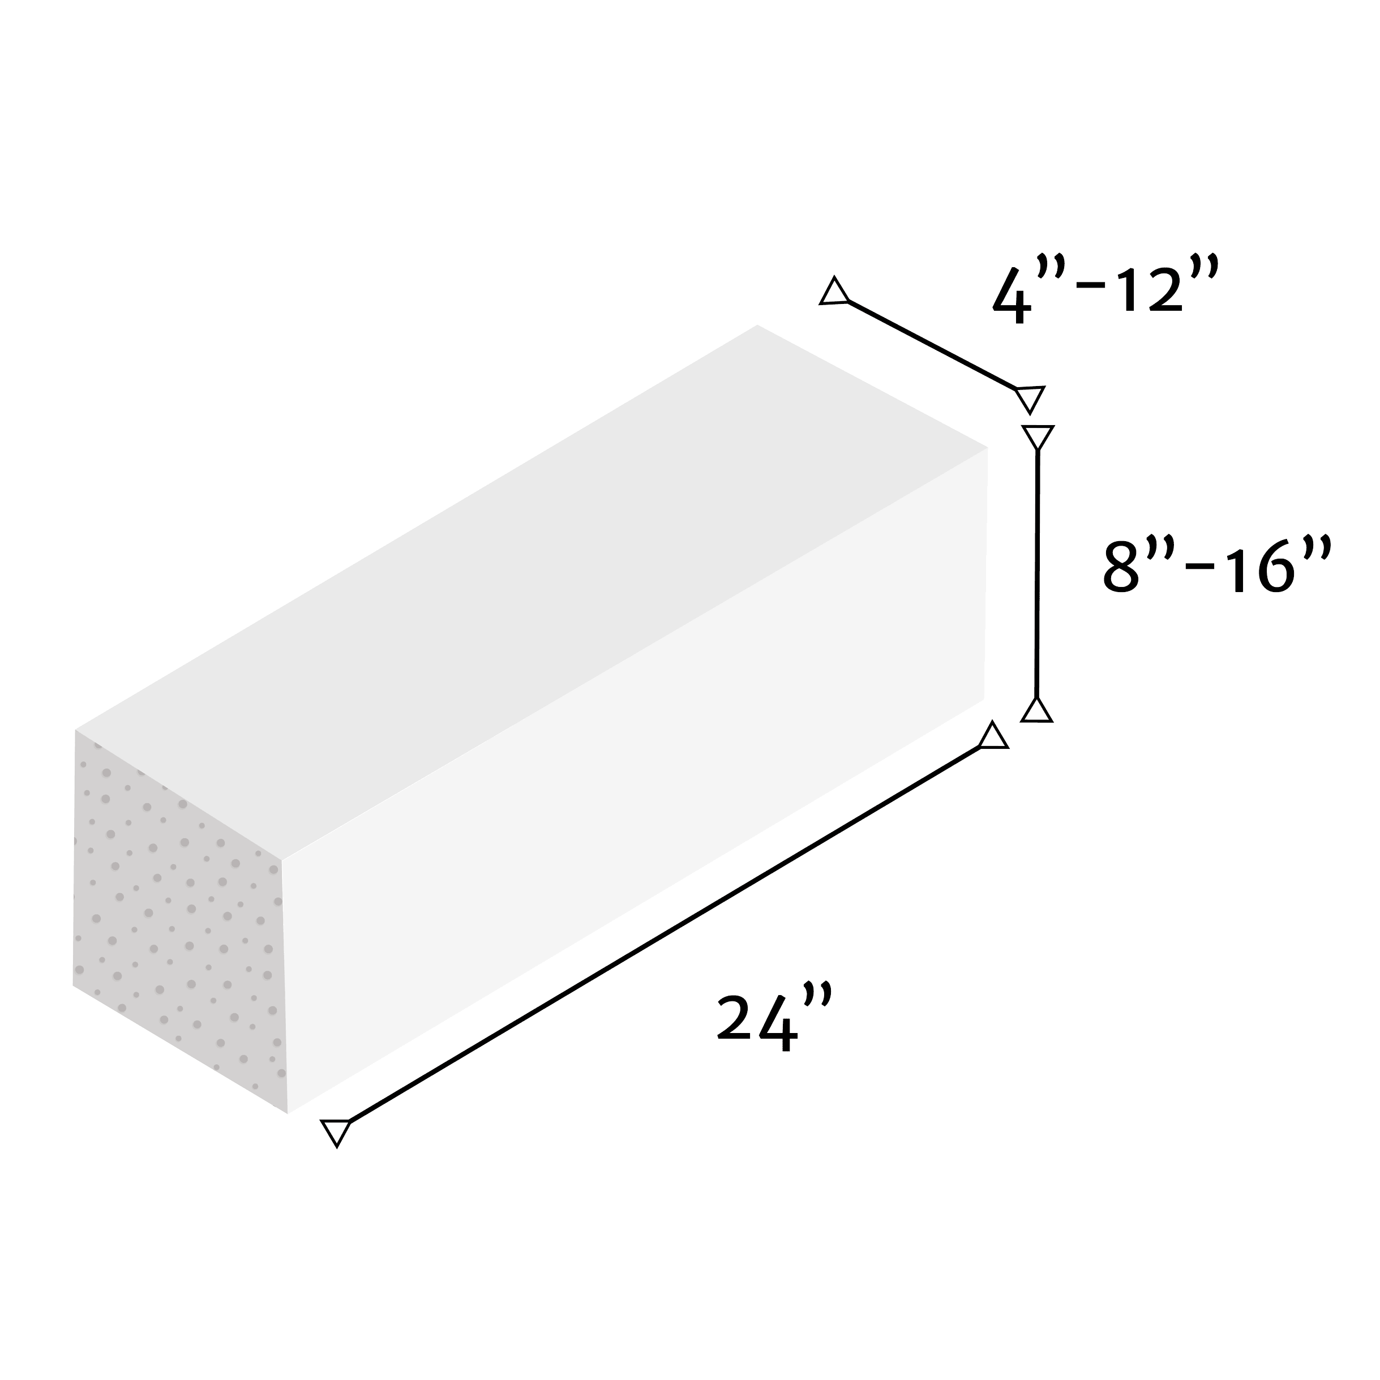
Confined Masonry Block
*Standard size shown above
Description Solid, lightweight modular block, confined with concrete columns and beams.
Application Load bearing and structural walls
Advantages Large dimension block Faster installation compared to traditional systems High quality and smooth finish
Weight 12 lbs/sq ft for 4” thick blocks

Slide 12
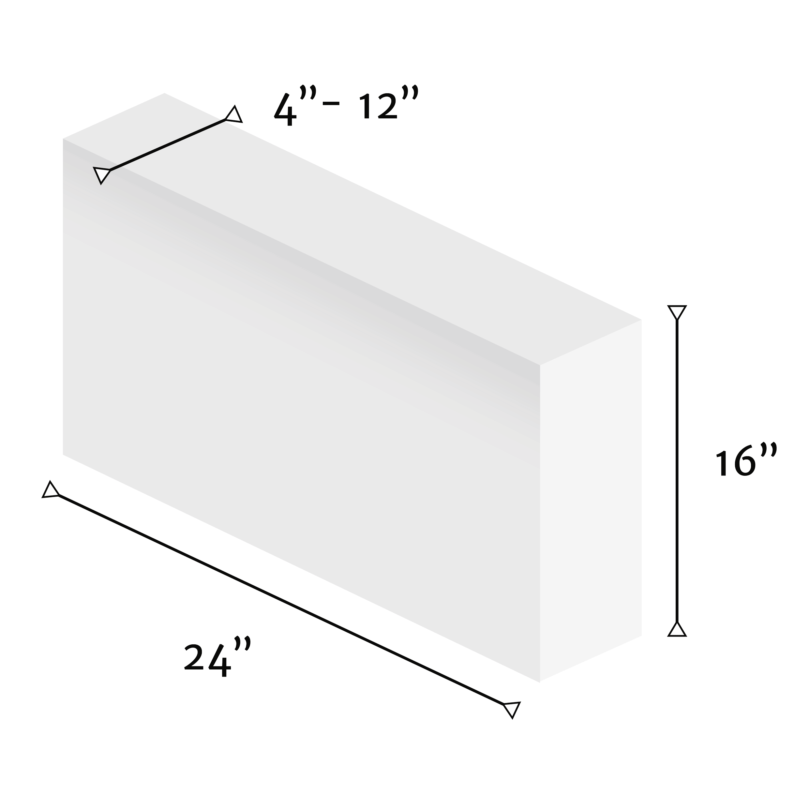
Modular Block
*Standard size shown above
Description Large dimension block
Application Non-load bearing partition walls up to 23’
Advantages Supports direct attachment of heavy loads (TV, cabinets, etc) Solid partition wall, resistant to structural movements Does not require additional reinforcement
Weight 10.7 lbs/sq ft for 4” thick blocks

Slide 13
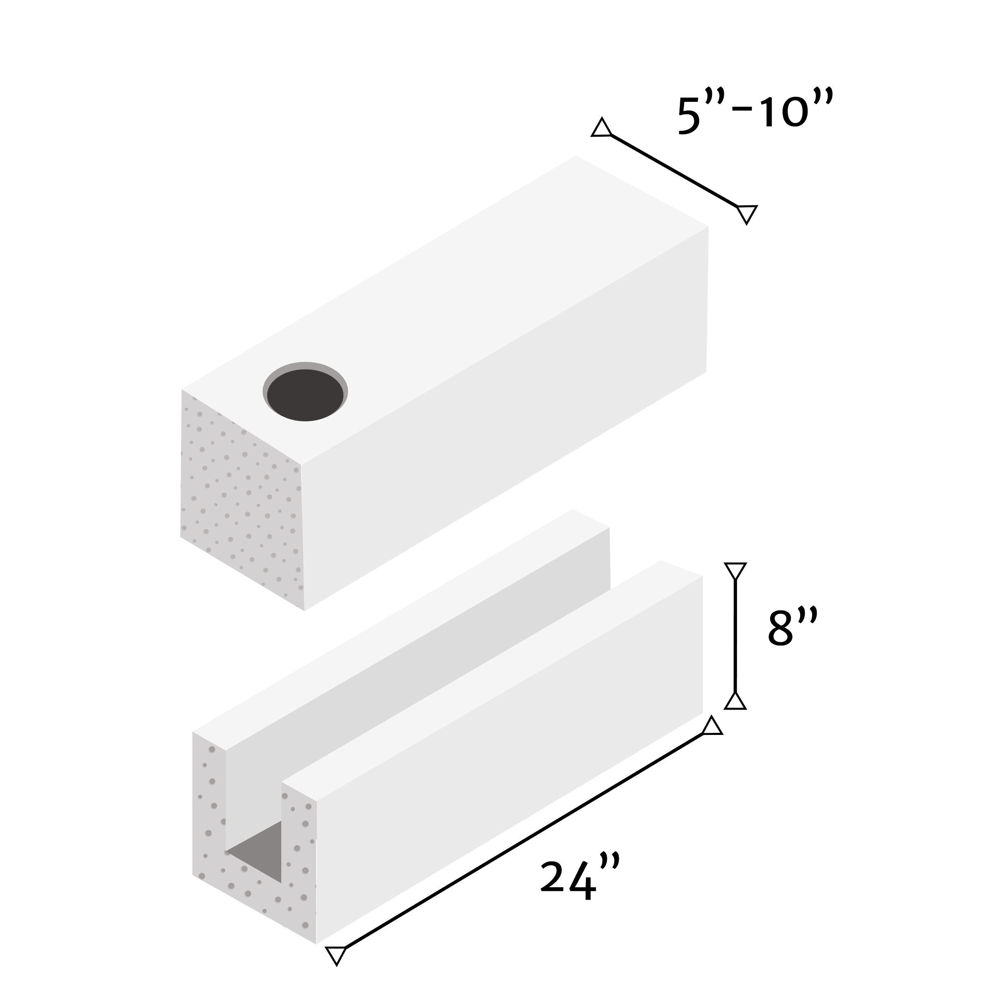
Reinforced Block
*Standard size shown above
Description Cored blocks with internal reinforcement made of rebar and concrete
Application Load bearing partition and exterior walls
Advantages Does not require additional structural support, no need for beams and columns Savings of 50% in rebar and concrete compared with traditional system
Weight 15 lbs/sq ft for 5” thick blocks without rebar or concrete

Slide 14
Contact for a quote
832-535-9489
Lacie@usmexadvisors.com
www.USMEXAdvisors.com

