Slide 1
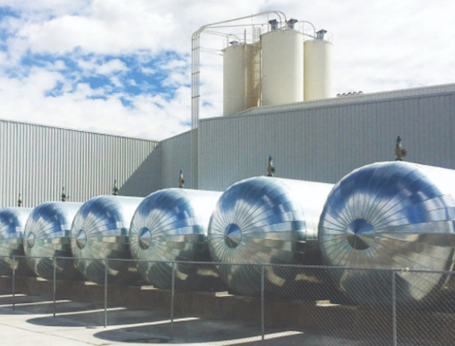
Catalog 2022

Slide 2
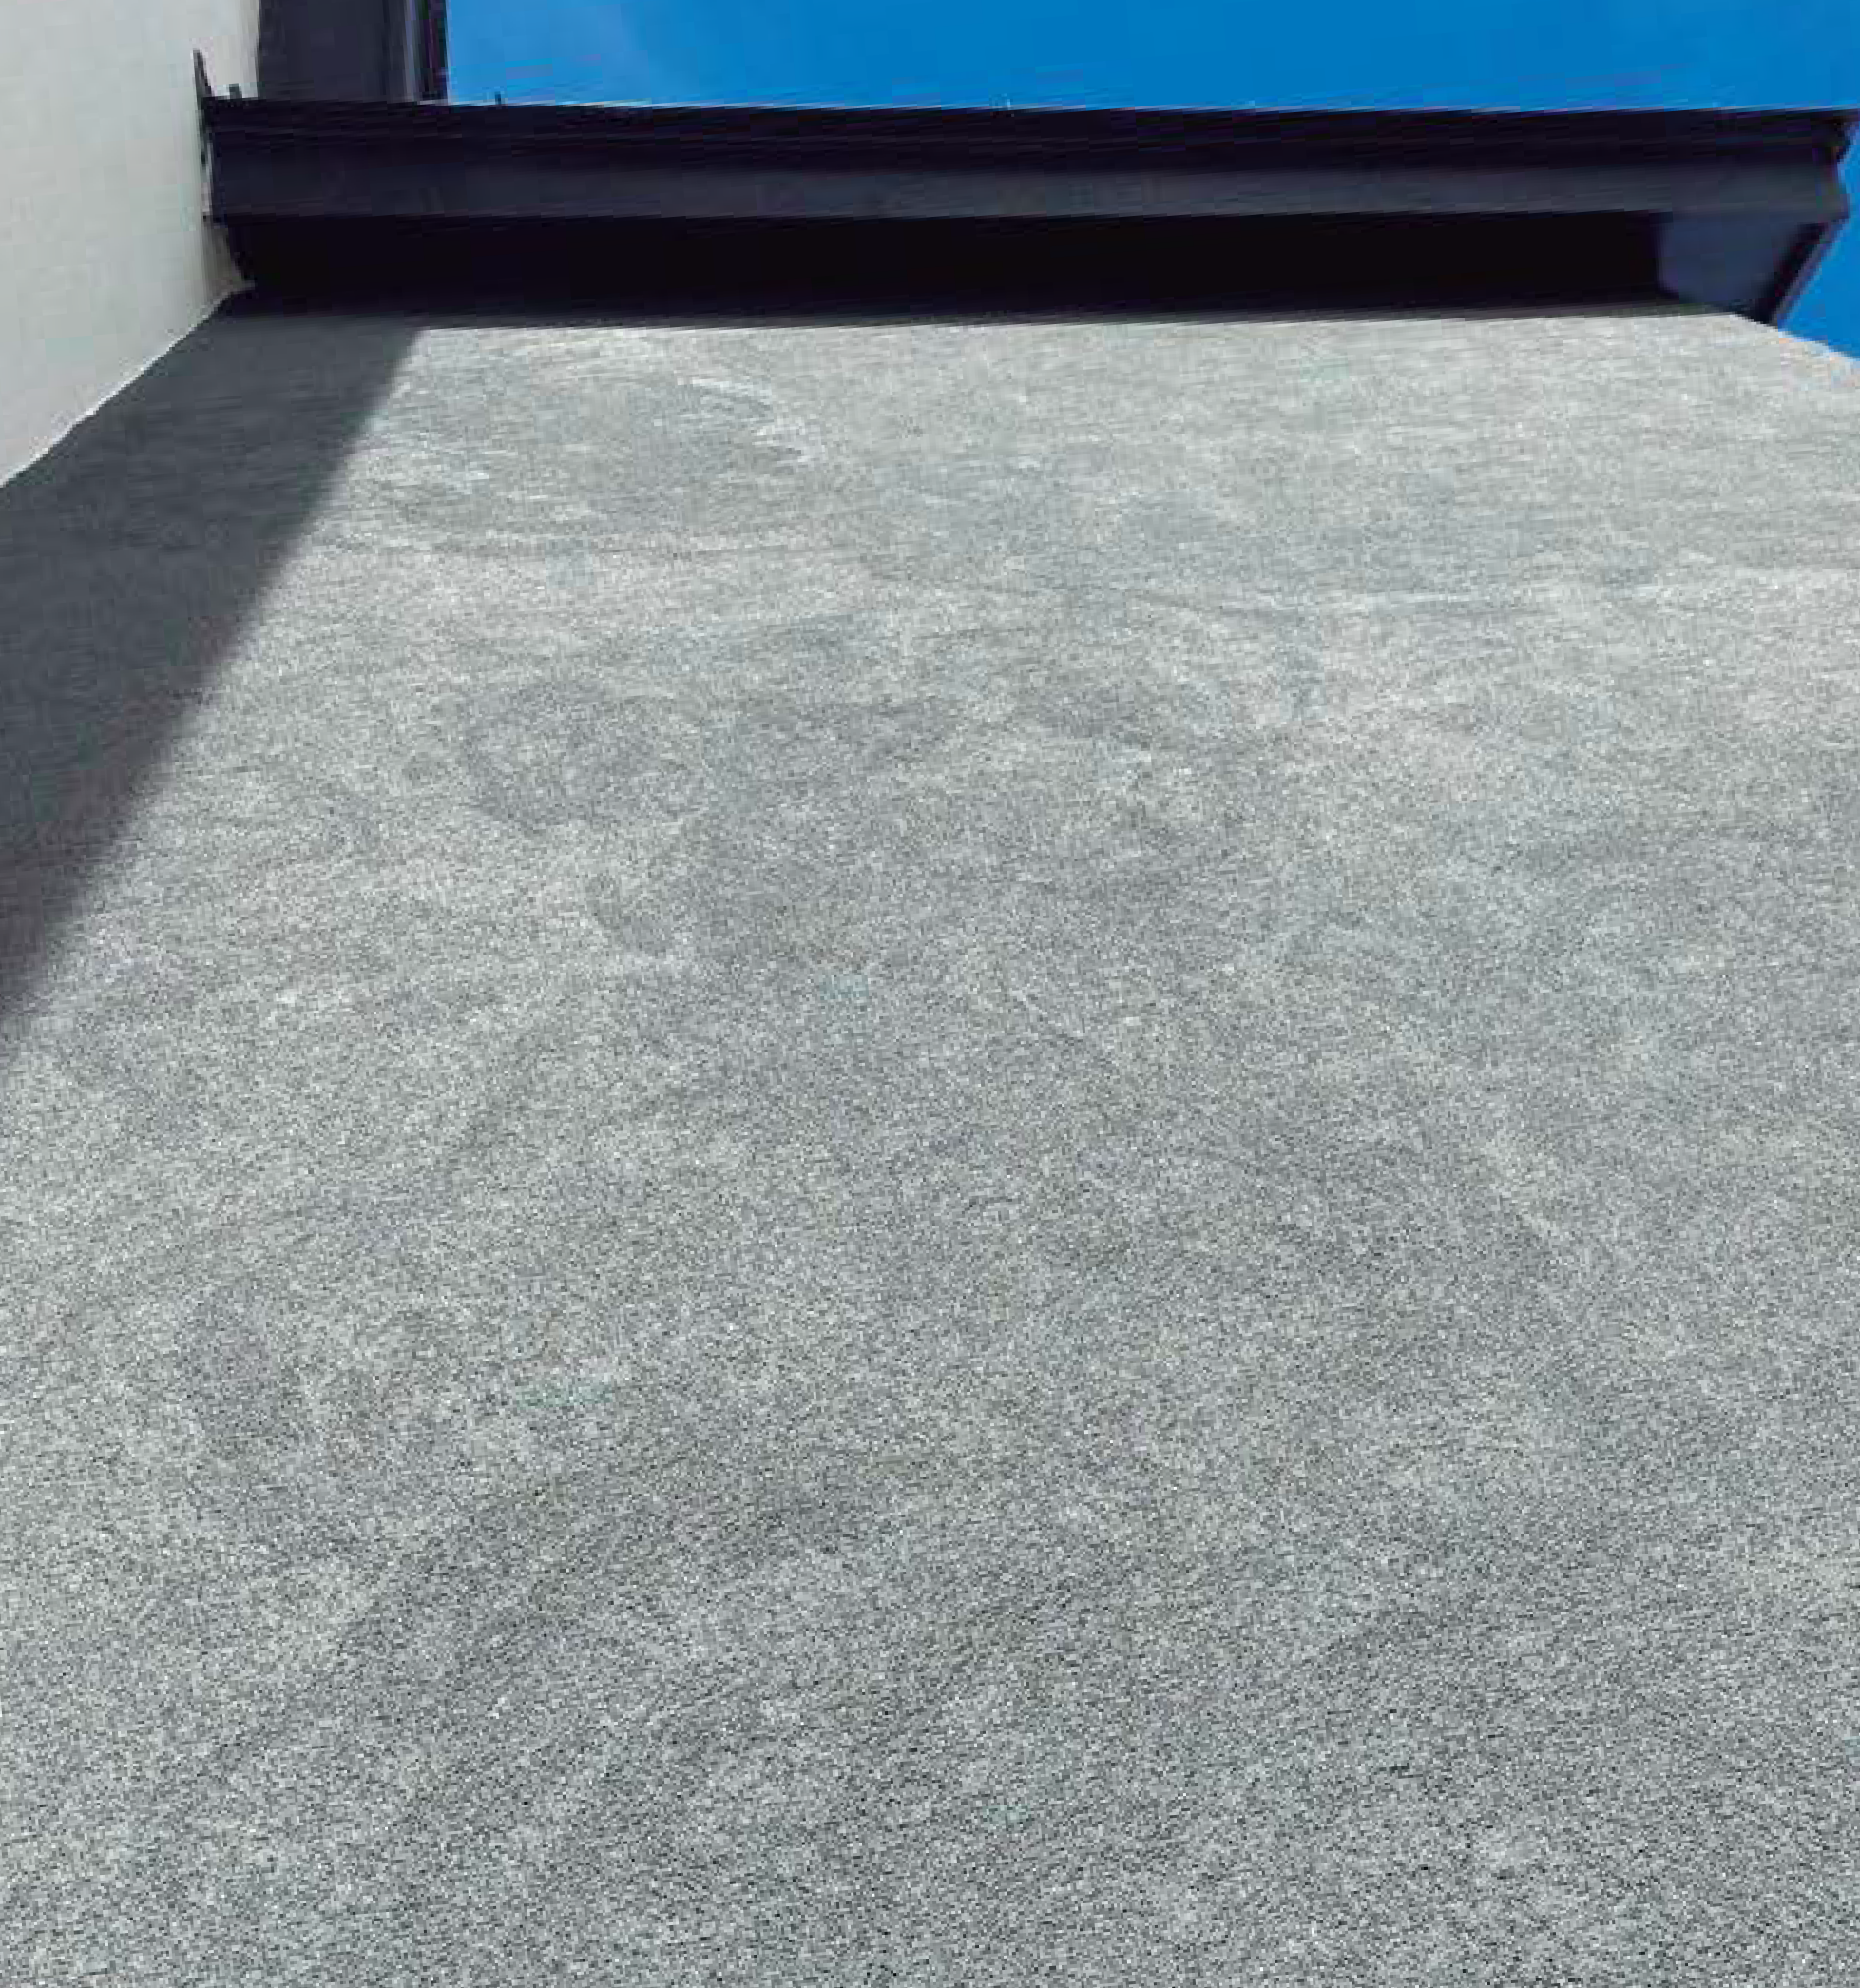

Slide 3
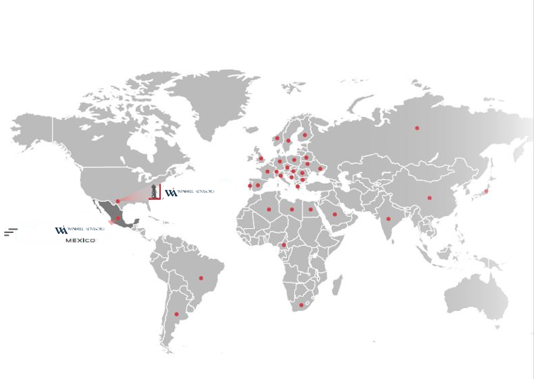
Winhill Advisors is partnered with global leader in AAC Mexico and Europe, a global leader in AAC with more than 50 years of experience, known as the most advanced developer, manufacturer and producer of AAC technology. The company has built over 1oo different plants in
20 countries on 6 different continents. We are the future of panels for walls and facades for residential, commercial and industrial buildings.

Slide 4
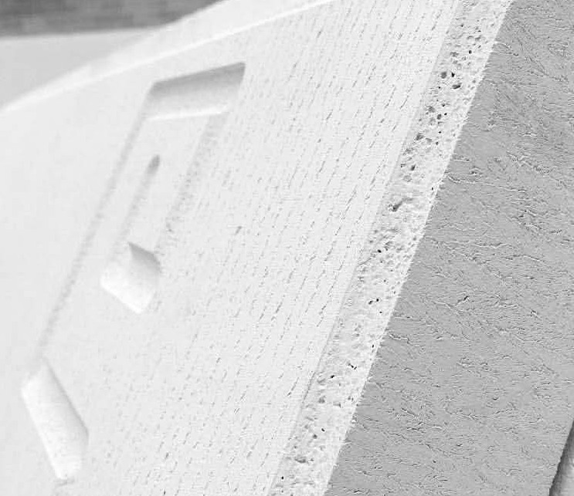
What is AAC?
Autoclaved Aerated Concrete (AAC) is a lightweight and ecofriendly concrete, commonly known as cellular concrete
AAC is manufactured with cutting-edge technology and natural materials such as: cement, lime, silica sand, and aluminum powder
AAC products include prefabricated panels and blocks of various sizes
AAC products are made 100% of natural materials, containing no foam or plastics.

Slide 5
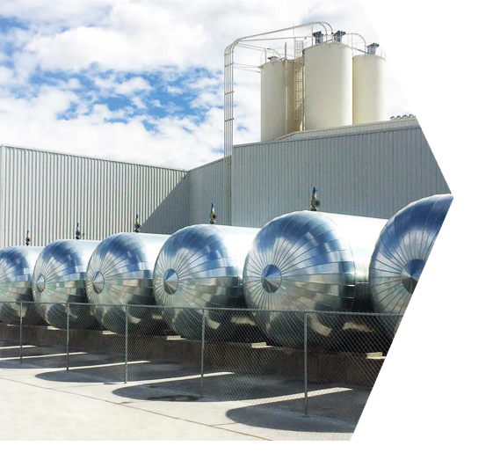
OUR
FACTORY
Our product is manufactured at the newest and largest AAC plant in North America with an annual production capacity of 32 million ft2.
We are currently shipping panels and blocks all over North America and Central America.
LOCATION/ 20 MILES NORTH MEXICO CITY

Slide 6
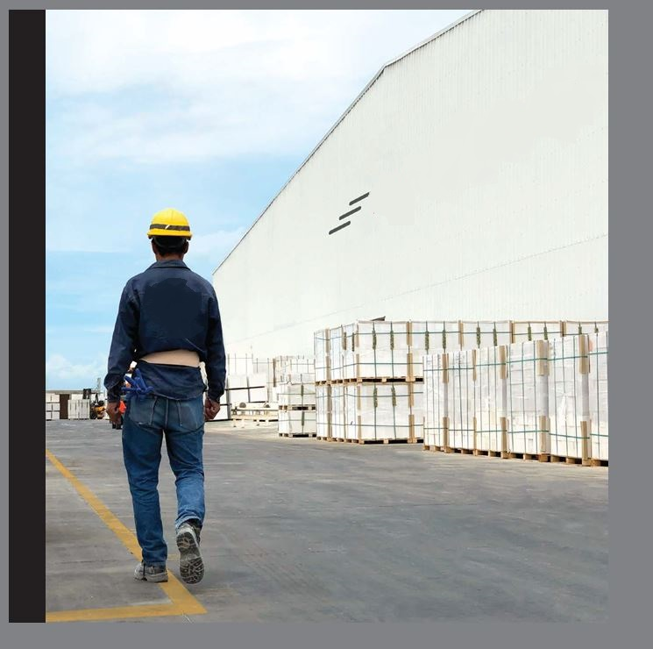
USMEX ADVISORS

Slide 7
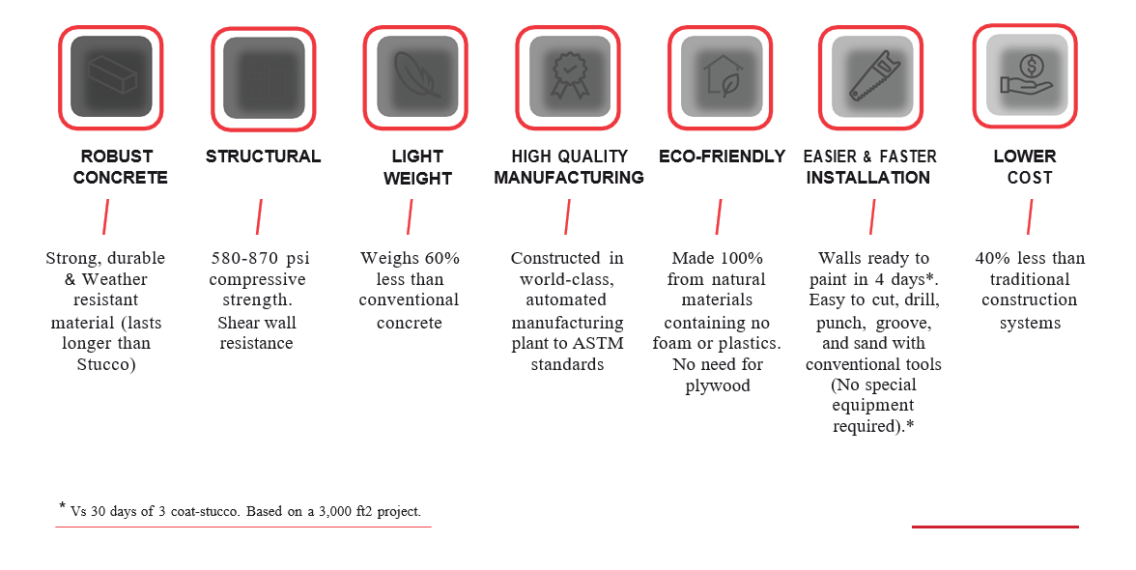
BUILDER & GENERAL CONTRACTOR

Slide 8
No interference with signal, coverage or footprint from 5G, WiFi or from your cellular provider.

Slide 10
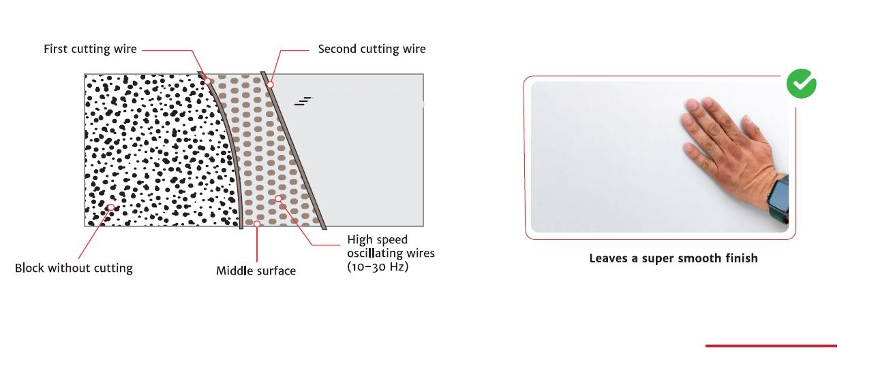

Slide 11
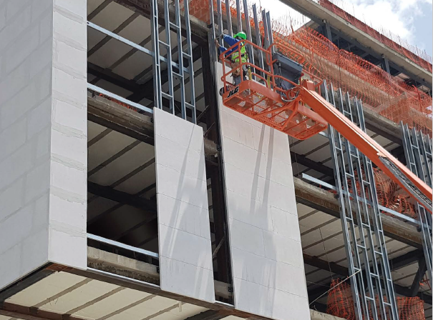

Slide 13
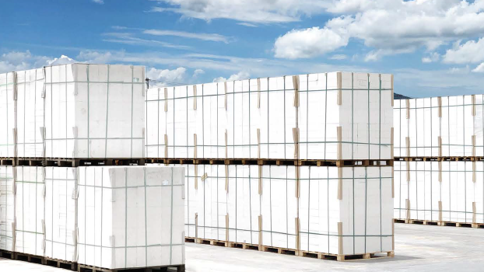

Slide 15
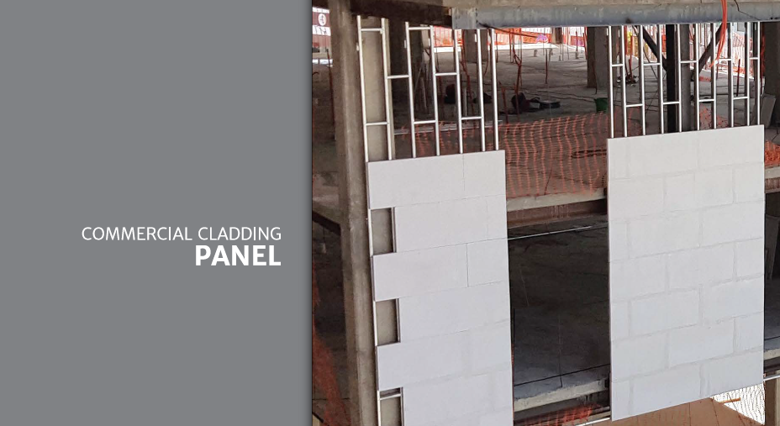

Slide 17
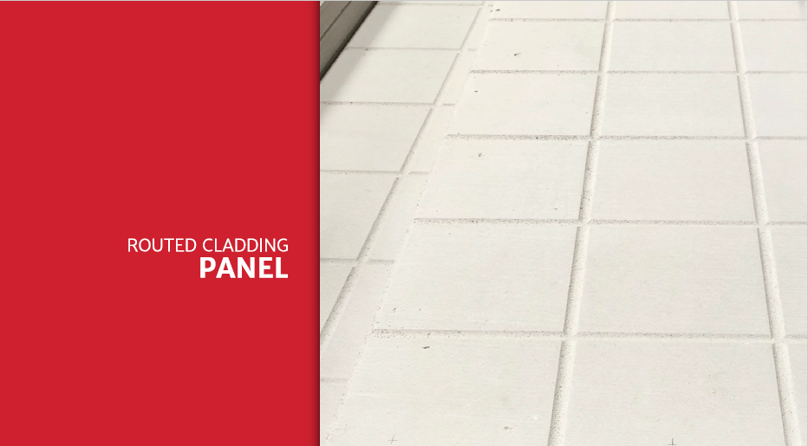

Slide 21
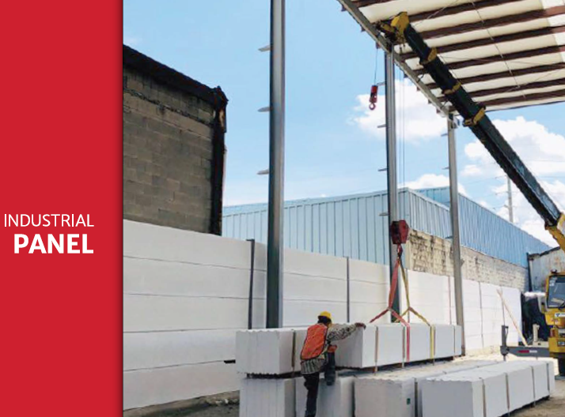

Slide 23
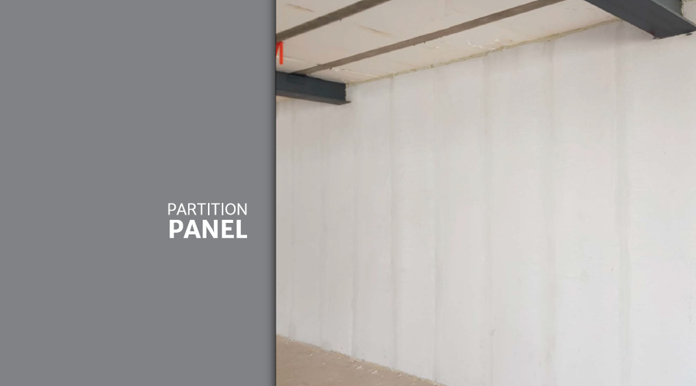

Slide 25
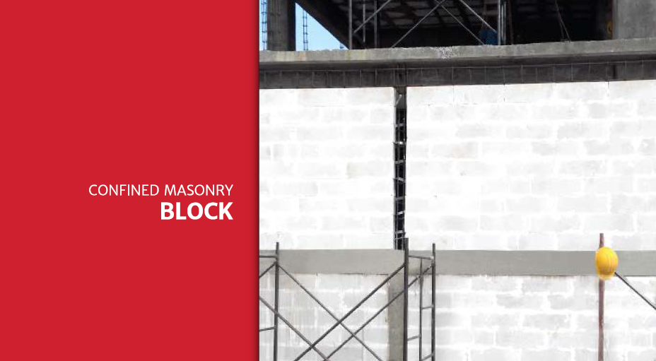

Slide 29
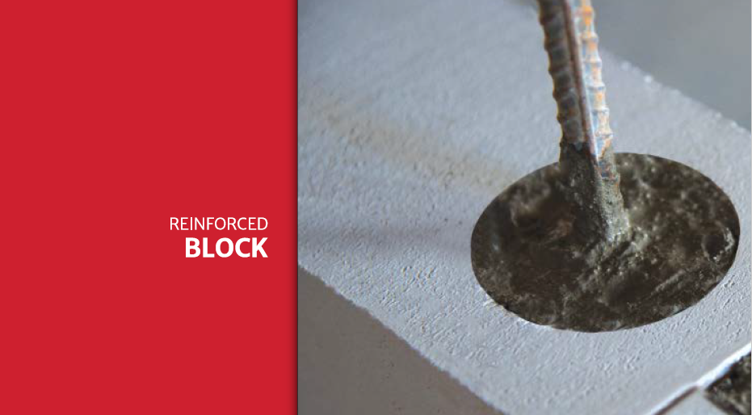

Slide 31
832-535-9489
Info@USMEXadvisors.com
www.USMEXAdvisors.com

